Slide 1



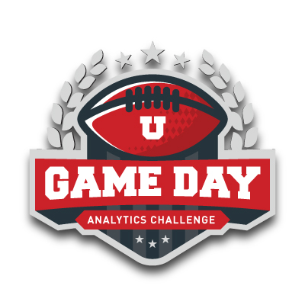
Data Chargers Graduate Team 16
Venkatachalam | Vinay Kumar | Akash | Solomon
Game Day Analytics Challenge 2023

Slide 2
Objectives
Analysis of Gameday Tweets
Application of Business analytics skill
Drawing key insights
Business recommendations

Slide 3




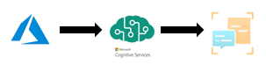
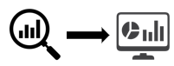
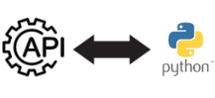

Methodology
Create Azure Cognitive Services and its corresponding Text Analytics API
Data collection
Data Preprocessing
Visualize data
Processes the text data and Analyze for text sentiment along with scores
Game Day Analytics Challenge 2023

Slide 4
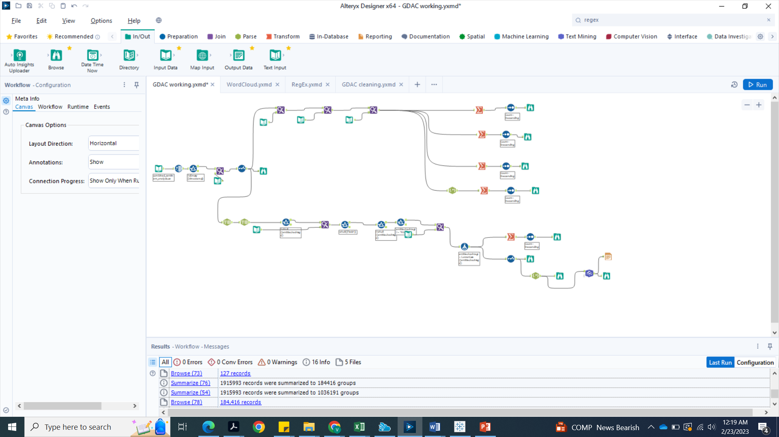
Data cleaning & Analysis using Alteryx Designer
Steps in Cleaning & Analysis:
Ranking of fields in the order of importance.
Replaced NULL values with ‘0’
Used Various Alteryx Functions -Data Cleansing, Filter, Summarize, Word Cloud and Render functions.

Slide 5
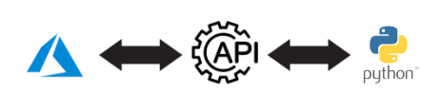
Sentiment Analysis
Sentiment Analysis is a popular technique used to extract opinions, attitudes, and emotions from text data.
Azure Cognitive services is a cloud-based platform that provides a set of APIs and services for natural language processing (NLP) and machine learning (ML) applications.
The Text Analytics API in Azure Cognitive services is specifically designed for sentiment analysis and can be used to extract insights from text data in multiple languages.
By combining Azure Cognitive Services API with python and pandas we can extract insights from large volumes of text data quickly and efficiently..
Game Day Analytics Challenge 2023

Slide 6
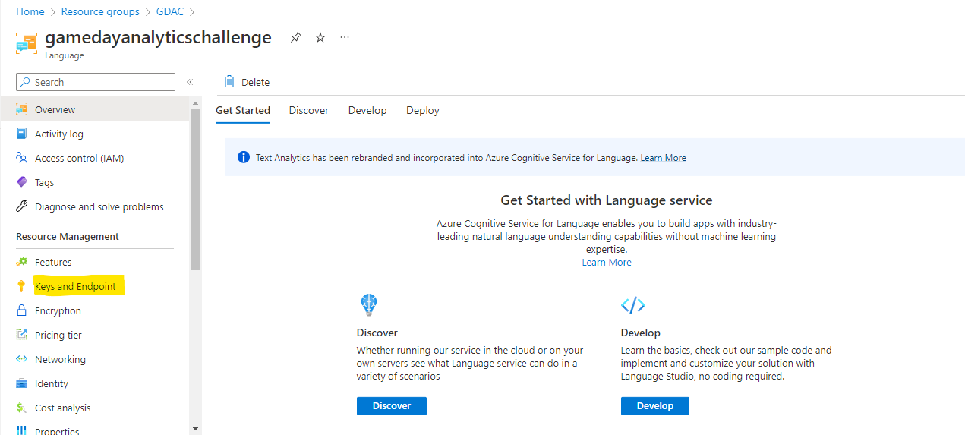
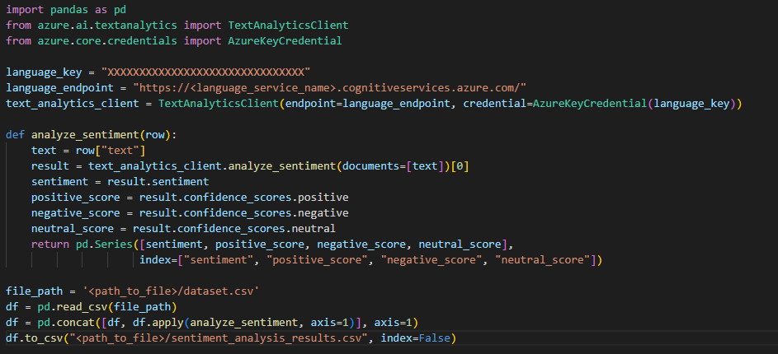
Packages Used:
Pandas
Azure ai text analytics
Game Day Analytics Challenge 2023

Slide 7
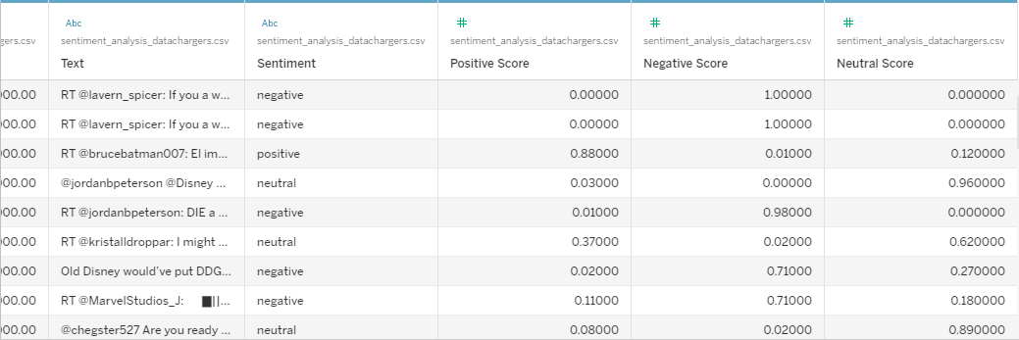
Azure Cognitive Services Text Analytics API provides sentiment analysis results in four categories:
Positive
Negative
Neutral
Mixed
The API also returns sentiment scores that range from 0 to 1, where 0 represents no sentiment and 1 represents strong sentiment.
Game Day Analytics Challenge 2023

Slide 8
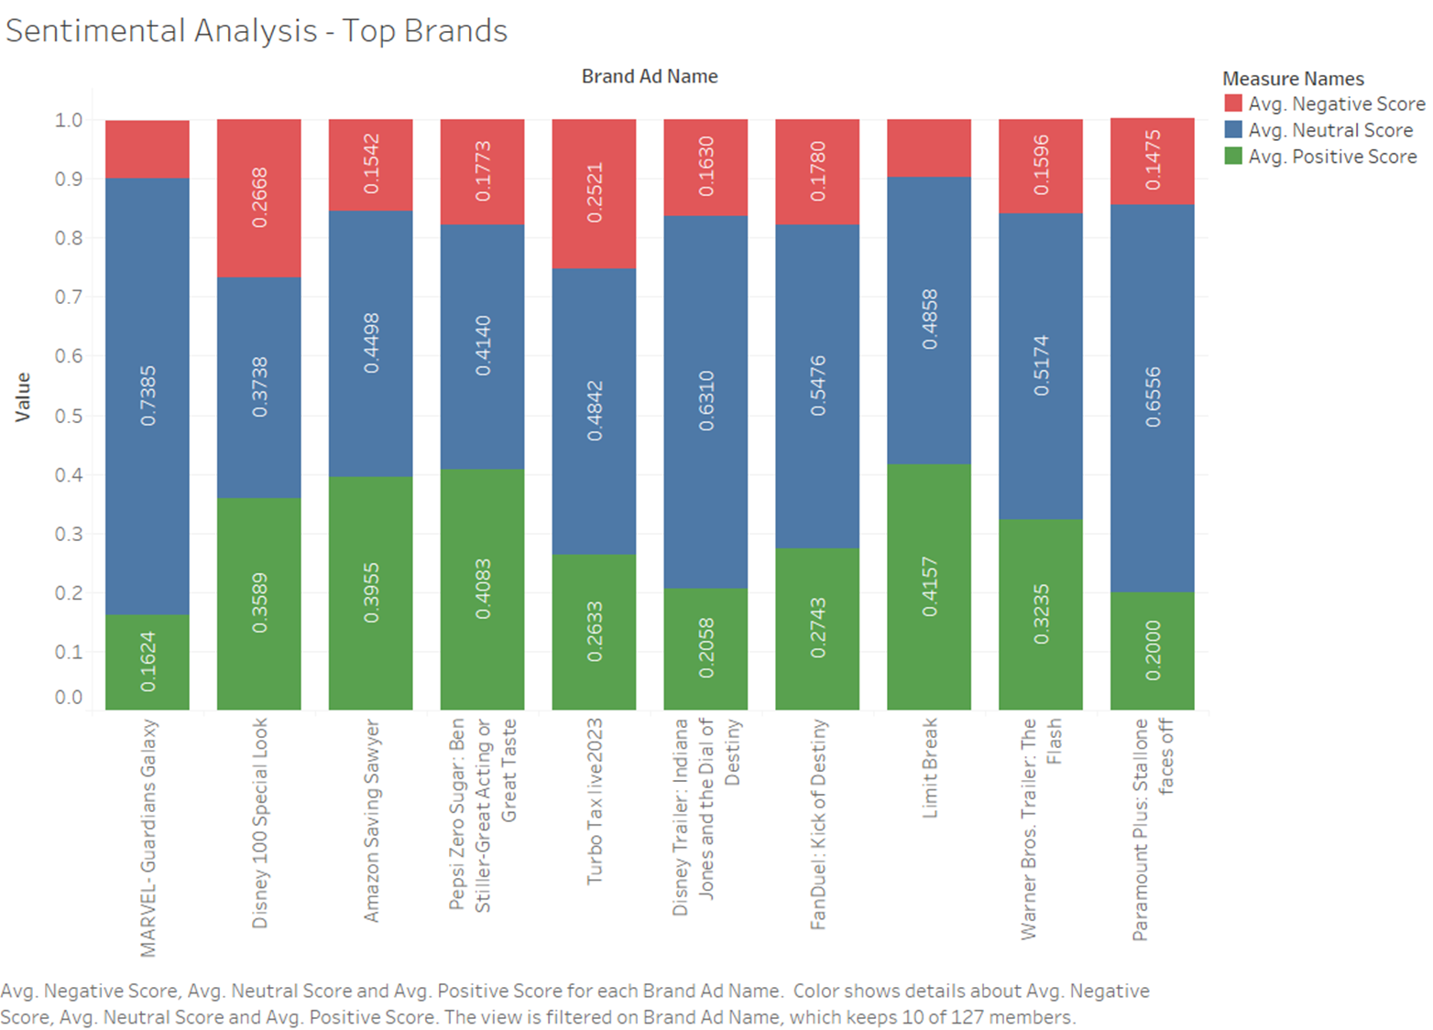
Key Insights
Sentiment score vs Brand Ad Name
The commercials by Limit Break and Pepsi during Super Bowl 57 weren't just crowd-pleasers, they also had the highest positive and neutral scores on Twitter.

Slide 9
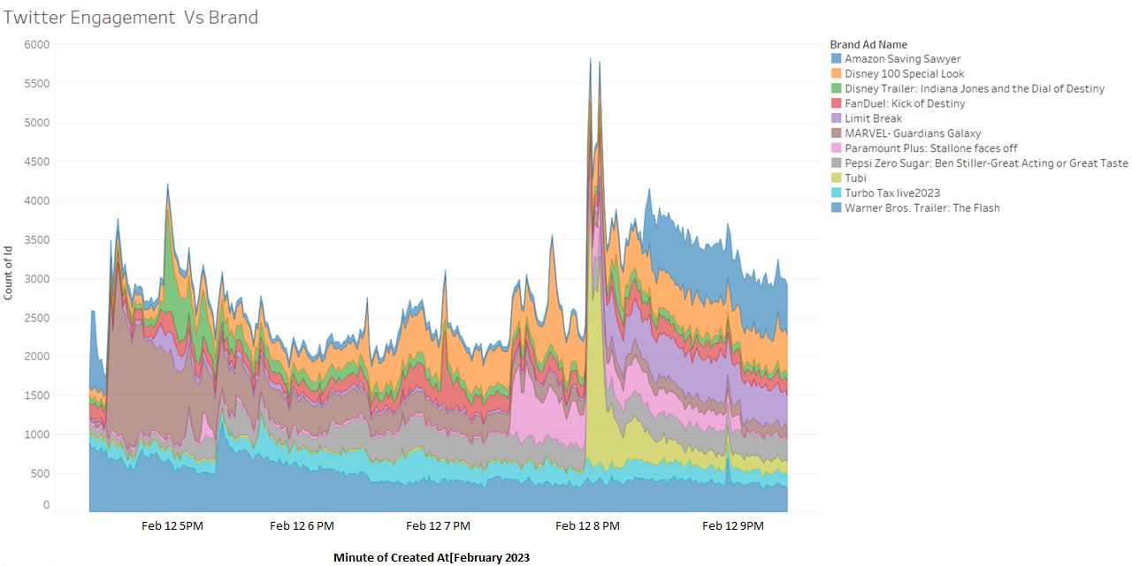
Twitter Engagement Vs Brand
The Spike in the twitter engagement is clearly visible whenever there is a play of a particular commercial.

Slide 10
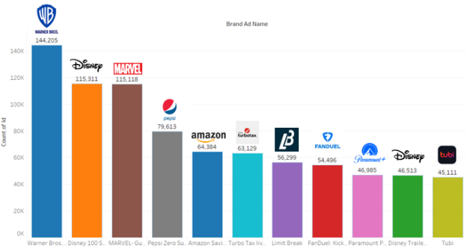
Brand Ad Name Vs Count of Tweets
The commercial that broke the Twitter: "The Flash" by Warner Bros takes the top spot.

Slide 11
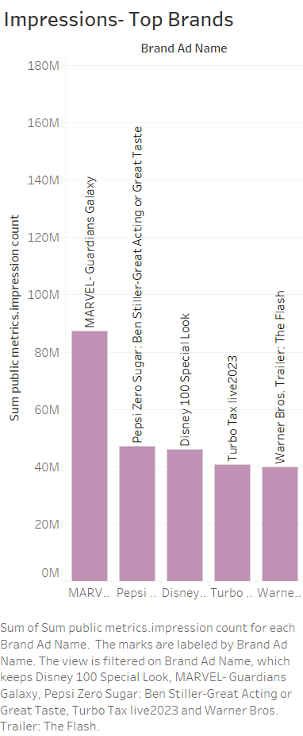
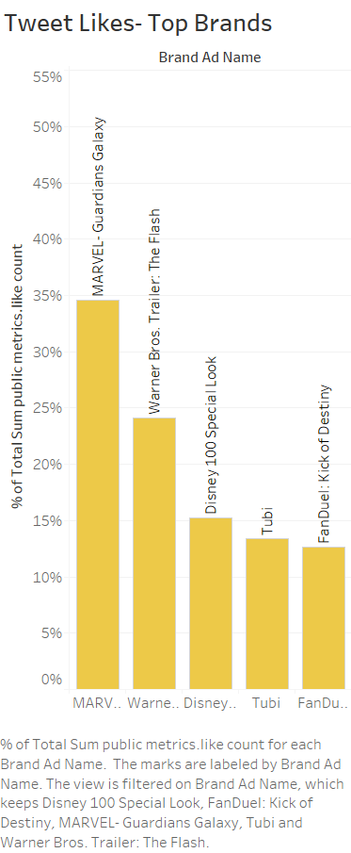
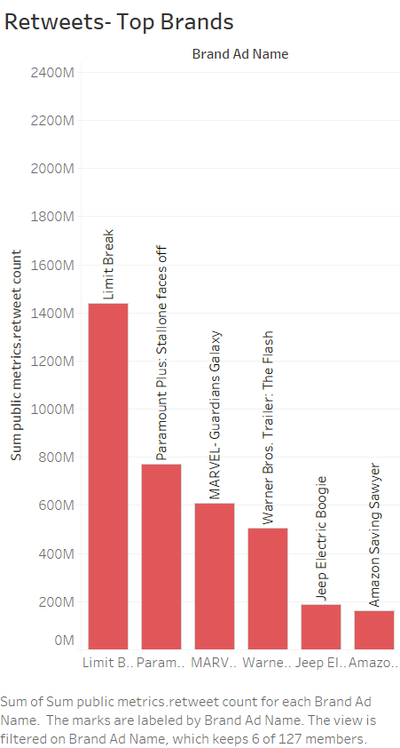
Tweet Impressions, Likes and Retweets

Slide 12

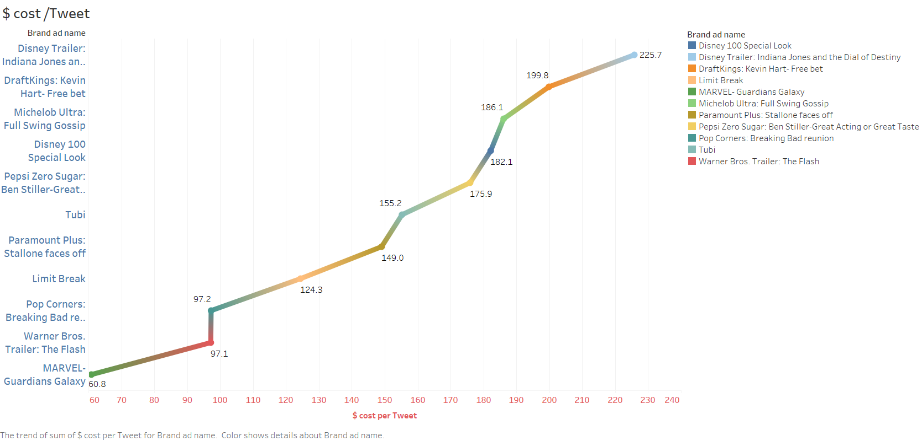
Key Insights
$Cost per Tweet Brand Ad wise
Best Bang for the Buck: Marvel’s Guardians of Galaxy with $60 per tweet.
Return on Investment is “ Grooooooot !!”

Slide 13
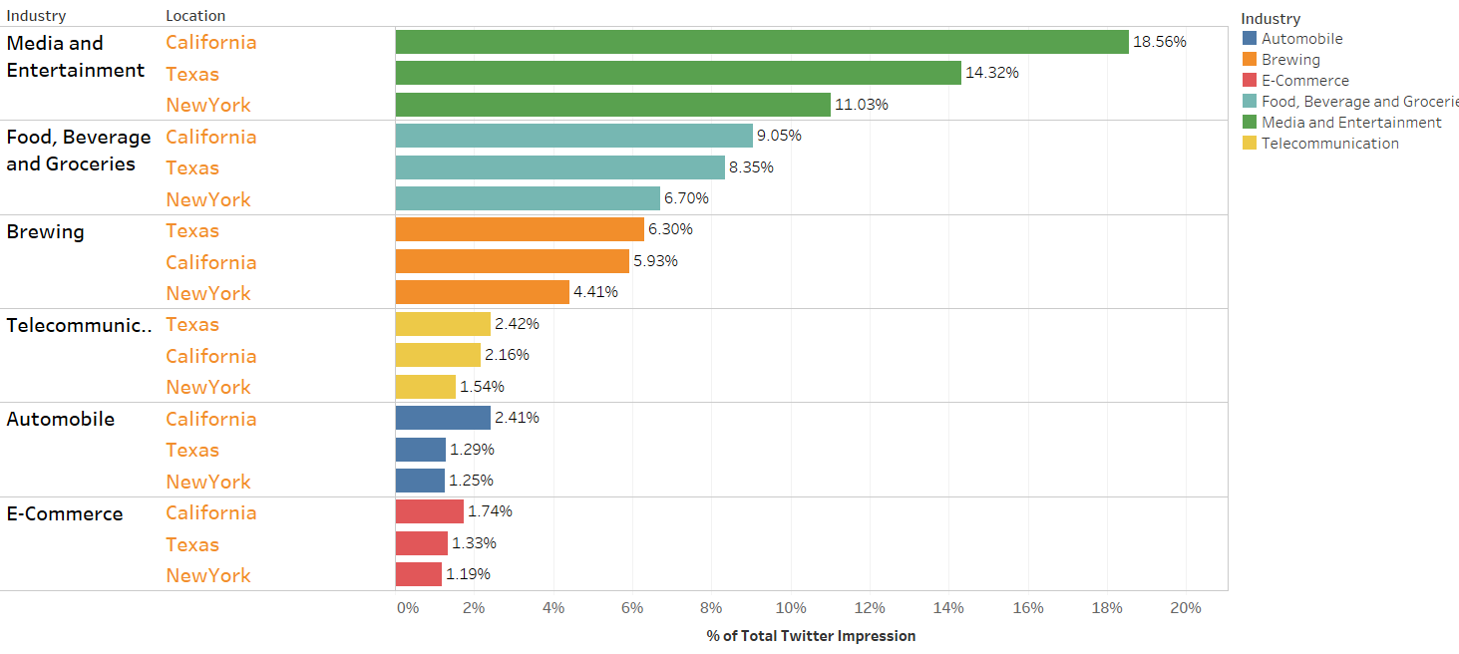
Key Insights
Tweet Impressions- Industry & Location

Slide 14
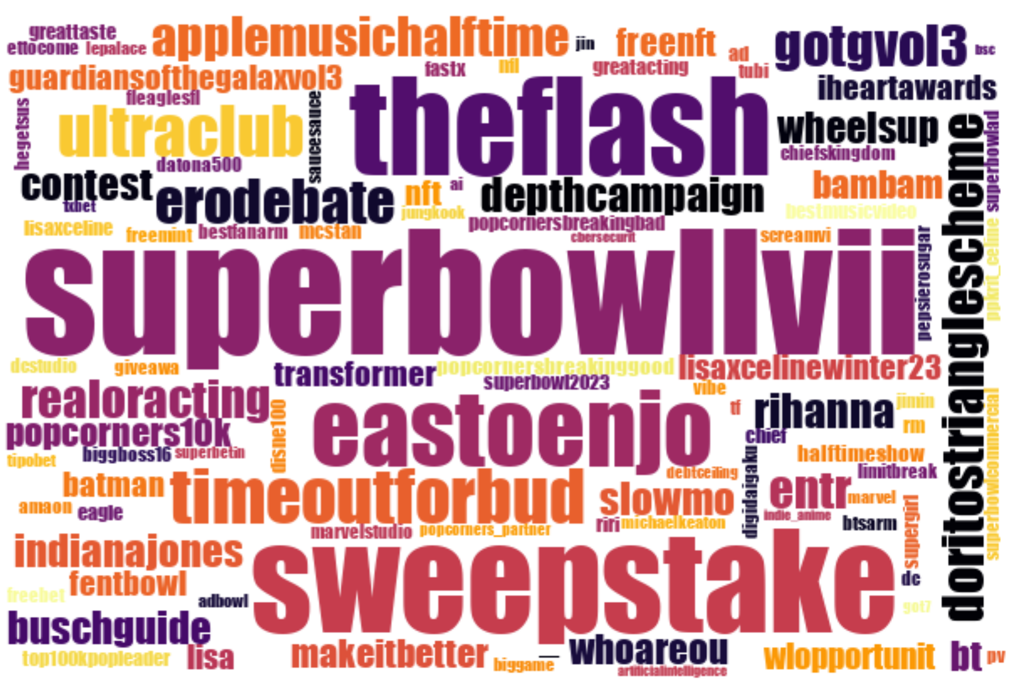
Key Insights
Word- Cloud( # Hashtags)
The “Superbowl-LVII” is the highest trending hashtag, followed by “The Flash” and “Sweepstake”.
Sometimes, even presence of celebrity may not generate the adequate buzz in creating the required connect. For example, Remy Martin ad by Serena Williams fumbled during big game which generated only 15771(0.82%) of the total tweets.

Slide 15

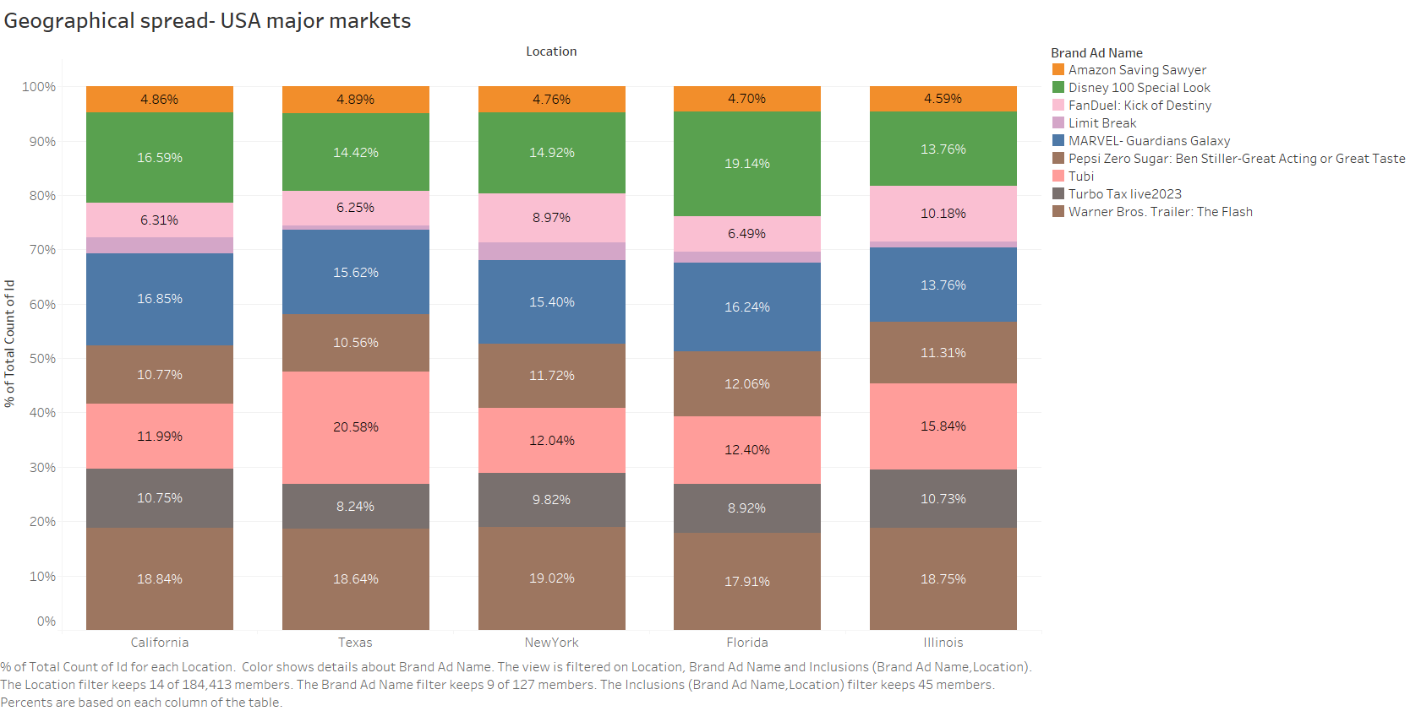
Uncover hidden gems with drill down analysis Tubi- Case study
Tubi has high tweet share of 20.58% in TEXAS Region

Slide 16
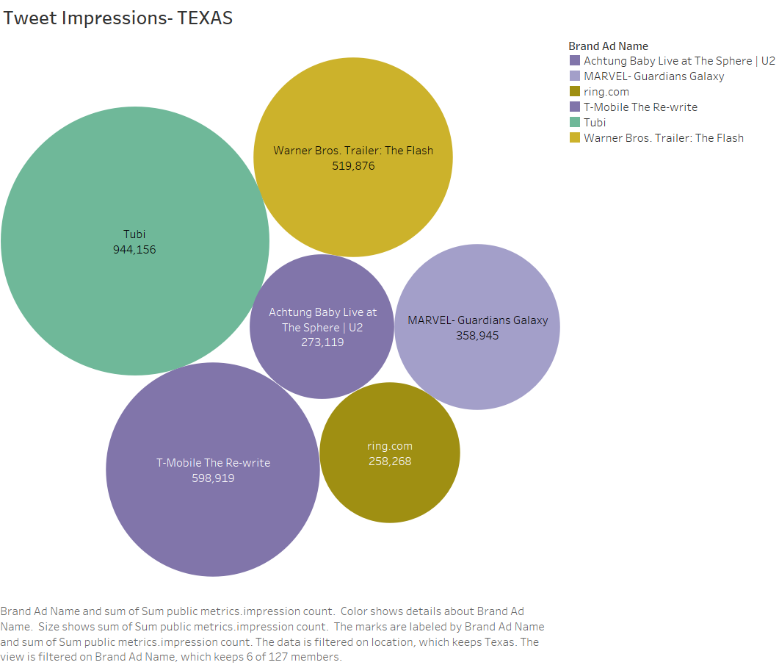
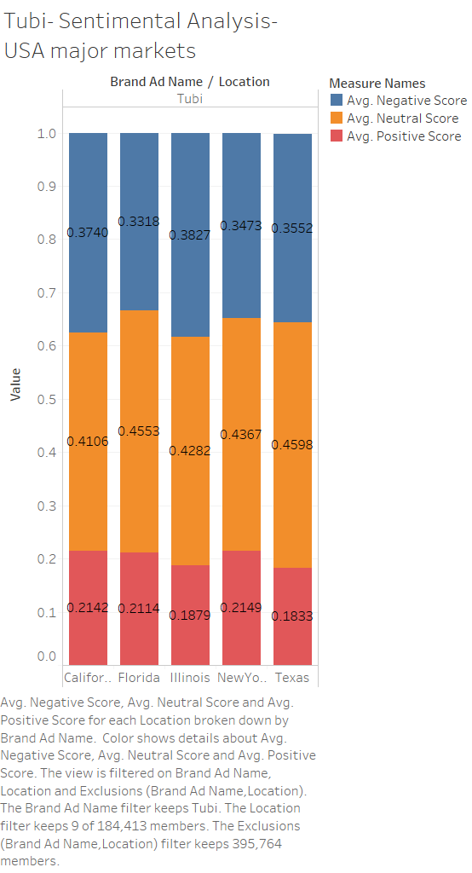
Tubi’s Impression and Sentiment Analysis

Slide 17
Tubi- Analysis Insights & Business recommendations
Tubi's "Interface Interruption" commercial created buzz among viewers with its creative advertising strategy . The ad is swooped in and left viewers yelling, then smiling.
In TEXAS, Tubi has highest twitter Impressions share, tweet Share in among all brands good sentiment Since it has very high reach.
Hence, Tubi can deploy necessary resources for converting the reach into revenue .This will improve the Tubi's KPIs such as
MAU (Monthly active Users)
CPM( Cost per million Users)
Further, Tubi can also focus on increasing their reach in other major markets thro such creative advertising commercials.
TEXAS Tweeters can't stop raving about Tubi due to it's highest impression share of 31.97%

Slide 18

What’s there in Store for Twitter
The data analysis can be used by Twitter to segment prices based on brand industry. Due to their strong engagement rates, it may charge extra for any media or entertainment brands.
Twitter has the ability to leverage location analysis data to generate income from brands that target high-buzz locations. In the California/Texas region, there may be a higher fee.
Twitter can charge extra for the adverts that are shown during periods of high interaction quarter periods.
Revenue from Data licensing .

Slide 19

Winning AD- combo for social media and Brand Advertisers
Buzzing Quarter + Media and Entertainment Sector + sweepstake + Ad duration (30 Sec) + Creative Strategy

